Slide 1
FA565 Business Ethics and Corporate Governance
Week 7: Board of Directors pt 1
Board Leadership & Company Purpose
Mark Elliot

Slide 2

1. Board Leadership and Company Purpose

Slide 3
Principles and Provisions of the Code
At the heart of this Code is an updated set of Principles that emphasise the value of good corporate governance to long-term sustainable success.’
‘By applying the Principles, following the more detailed Provisions and using the associated guidance, companies can demonstrate throughout their reporting how the governance of the company contributes to its long-term sustainable success and achieves wider objectives.’
(From the 2018 UK CG Code Introduction).

Slide 4
UK Corporate Governance Code
Principles
A-R
Provisions
1-41
Guidance on Board Effectiveness

Slide 5
Principles A-E
Board Leadership and Company Purpose

Slide 6
Principle A
“A successful company is led by an effective and entrepreneurial board, whose role is to promote the long-term sustainable success of the company, generating value for shareholders and contributing to wider society.”

Slide 7
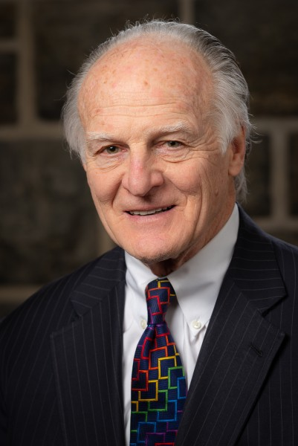
Board Leadership Lessons from a Long-Time CEO
Bill Murdy: Director of Vectus (NYSE)
https://youtu.be/1uwXyonwc5U?t=29

Slide 8
Principle B
“The board should establish the company’s purpose, values and strategy, and satisfy itself that these and its culture are aligned. All directors must act with integrity, lead by example and promote the desired culture.”

Slide 9

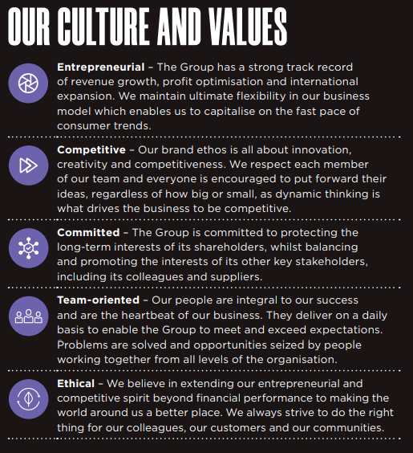

Extract from JD Sports Fashion Plc 2022 Annual Report

Slide 10
Principle C
“The board should ensure that the necessary resources are in place for the company to meet its objectives and measure performance against them. The board should also establish a framework of prudent and effective controls, which enable risk to be assessed and managed.”

Slide 11
Principle D
“In order for the company to meet its responsibilities to shareholders and stakeholders, the board should ensure effective engagement with, and encourage participation from, these parties.”

Slide 12
Principle E
“The board should ensure that workforce policies and practices are consistent with the company’s values and support its long-term sustainable success. The workforce should be able to raise any matters of concern.”

Slide 13
Provisions 1-8
Board Leadership and Company Purpose

Slide 14
Provision 1
The board should assess the basis on which the company generates and preserves value over the long-term.
It should describe in the annual report how opportunities and risks to the future success of the business have been considered and addressed, the sustainability of the company’s business model and how its governance contributes to the delivery of its strategy.
Notes:
PESTEL/SWOT Analysis are useful tools for this

Slide 15
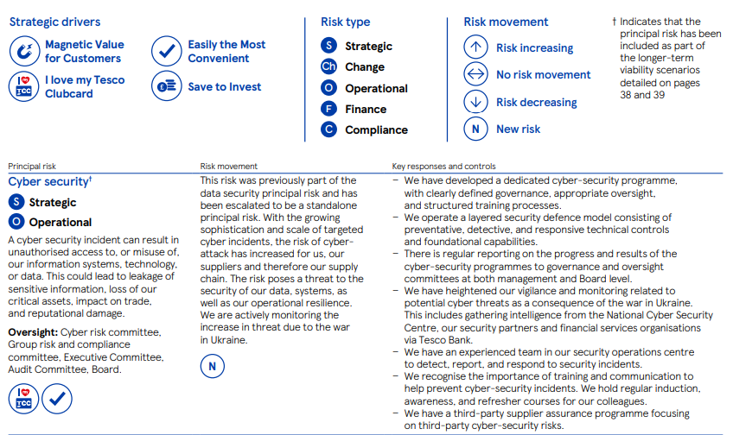
Example – Tesco Plc (2022) – Risk Register
Tesco Plc 2022 Annual Report (p33)
https://www.tescoplc.com/media/759057/tesco-annual-report-2022.pdf

Slide 16

Provision 2
The board should assess and monitor culture. Where it is not satisfied that policy, practices or behaviour throughout the business are aligned with the company’s purpose, values and strategy, it should seek assurance that management has taken corrective action.
Reminder: This links to Principle B, which talks about promoting the desired culture.

Slide 17

Group Exercise – Word Cloud
1) What types of attributes indicate a desirable culture within an organisation?
2) What would a problematic organisational culture look like?
Slido.com
#FA565 April25

Slide 18
Healthy Culture
Culture Problem
Honesty
Openness
Respect
Adaptability
Reliability
Recognition
Acceptance of challenge
Accountability
A sense of shared purpose
Silo thinking
Dominant chief executive
Leadership arrogance
Pressure to meet the numbers/overambitious targets
Lack of access to information
Low levels of meaningful engagement between leadership and employees
Lack of openness to challenge
Tolerance of regulatory or code of ethics breaches
Short-term focus
Misaligned incentives
Source: Guidance on Board Effectiveness (FRC, 2018)

Slide 19
Reminder: Principle D
“In order for the company to meet its responsibilities to shareholders and stakeholders, the board should ensure effective engagement with, and encourage participation from, these parties.”

Slide 20
Provision 3
The chair should seek regular engagement with major shareholders in order to understand their views on governance and performance against the strategy.
Notes:
When the FRC has reviewed Corporate Governance reporting, there has been some criticism of stakeholder engagement being one-directional and informational.

Slide 21
Provision 4
When 20% or more of votes have been cast against the board recommendation for a resolution, the company should explain, when announcing voting results, what actions it intends to take to consult shareholders in order to understand the reasons behind the result.
Notes:
When the FRC has reviewed Corporate Governance reporting, there has been some criticism of stakeholder engagement being one-directional and informational.

Slide 22
Provision 5
The board should understand the views of the company’s other key stakeholders and describe in the annual report how their interests have been considered in board discussions and decision-making. For engagement with the workforce, one or a combination of the following methods should be used:
a director appointed from the workforce;
a formal workforce advisory panel;
a designated non-executive director.
If the board has not chosen one or more of these methods, it should explain what alternative arrangements are in place and why it considers that they are effective.

Slide 23
Group Discussion
How can the board encourage engagement with, and participation from, all stakeholder groups?
Are there any differences in how they can or should engage with different types of stakeholders?

Slide 24
Sources of Stakeholder Feedback
Contacts with key customers
Customer complaints and satisfaction data
Supplier feedback
Surveys
Social media
Bespoke engagement activities on specific issues
for example, with trade unions, special interest groups or the local community

Slide 25
Poor Decision-Making
Dominant personalities
Insufficient diversity of perspective
Compliance mindset
Insufficient knowledge and ability to test underlying assumptions
Failure to listen to and act upon concerns that are raised
Failure to recognise the consequences of self-interest and other poor ethical standards
Lack of openness or debate
Complacent attitudes
Inability to challenge effectively
Inadequate information or analysis
Poor quality papers
Lack of time for debate and truncated debate
Undue focus on short-term time horizons
Insufficient notice
Excess focus on risk mitigation or insufficient attention to risk

Slide 26
Provision 6
There should be a means for the workforce to raise concerns in confidence and – if they wish – anonymously. The board should routinely review this and the reports arising from its operation. It should ensure that arrangements are in place for the proportionate and independent investigation of such matters and for follow-up action.

Slide 27
Employee Feedback – Examples
Hosting talent breakfast/lunches, town halls and open-door days
Listening groups for frontline workers and supervisors
Focus or consultative groups
Meeting groups of elected workforce representatives
Meeting future leaders without senior management present
Social media updates
Visiting regional and overseas sites
Inviting colleagues from different business functions to board meetings
Employee AGMs
Involvement in training and development activities
Surveys
Digital sharing platforms
Establishing mentoring between non-executive directors and middle managers

Slide 28
Provision 7
The board should take action to identify and manage conflicts of interest, including those resulting from significant shareholdings, and ensure that the influence of third parties does not compromise or override independent judgement.

Slide 29
Provision 8
Where directors have concerns about the operation of the board or the management of the company that cannot be resolved, their concerns should be recorded in the board minutes.
On resignation, a non-executive director should provide a written statement to the chair, for circulation to the board, if they have any such concerns.

Slide 30
Activity
Car Group Online Plc

Slide 31
Car Group Online Plc
Use the extract from Car Group Online Plc’s Annual Report to answer the questions.
1) What does the UK Corporate Governance Code (2018) recommend that a company’s culture should promote?
Evaluate how Car Online Group plc complies with the Code in this regard, using THREE examples from the information provided.

Slide 32
Car Group Online Plc
2) Using two examples from the provided information, evaluate the extent to which Car Group Online plc complies with Principle B and Provision 2 of the Code.

Slide 33
Car Group Online Plc
3) Principle E and which Provisions (1-8) are relevant to Car Online Group plc’s engagement with their workforce?
Evaluate Car Online Group Plc’s application of this Principle and Provisions using the information provided.
Suggest future actions to better comply with the Code in this respect.

